Slide 1
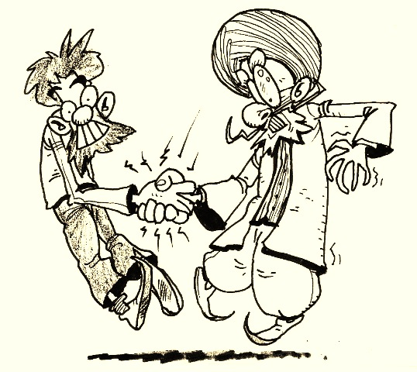
Electricity and Electrical Circuits
Introduction

Slide 2
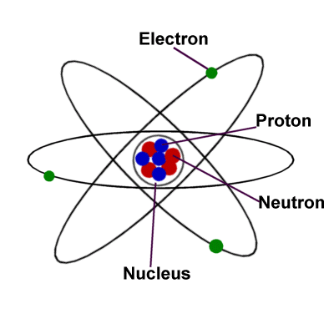
As we have seen in our study of chemistry, matter is composed of atoms, which are composed of protons, neutrons, and electrons.

Slide 3
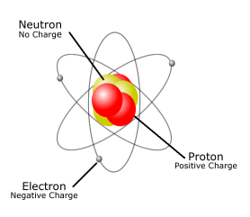
The protons are positively charged and are found “locked” in the nucleus with the neutrons.
The electrons are negatively charged and are moving around in the electron clouds, and are not “locked” into position.

Slide 4
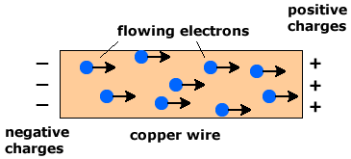
In fact, electrons can and do move between atoms, and can be transferred to other materials and move around quite freely at times.
This “free movement” of electrons is what we call electricity. Thereby, generating ELECTRIC CURRENT.

Slide 5
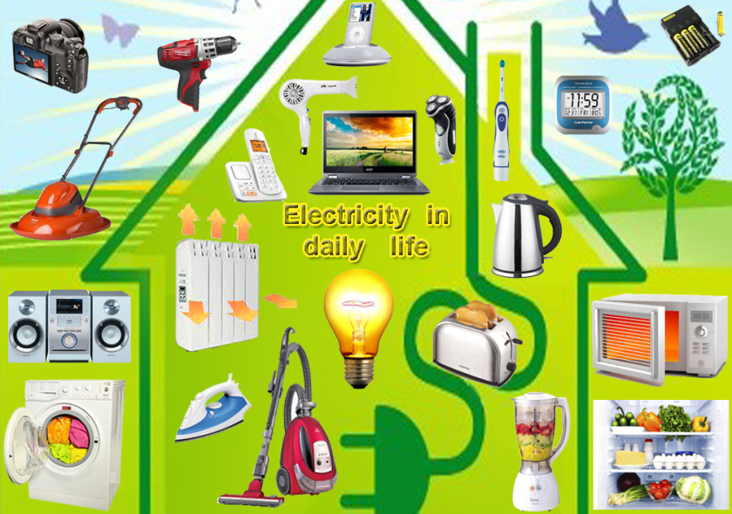
Electricity is a form of energy that can be easily changed to other forms.

Slide 6
WHERE DOES THIS ELECTRICITY COME FROM?
Mainly 2 sources:-
POWER STATIONS
ELECTRIC CELLS( BATTERIES)

Slide 7
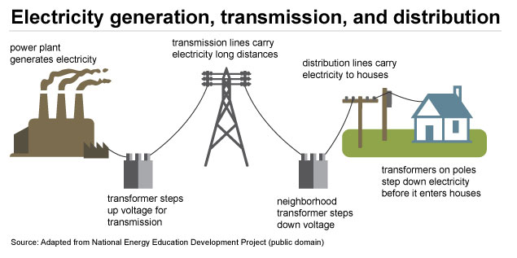
POWER STATION

Slide 8
HOW DOES AN ELECTRICAL APPLIANCE WORK?
To make sure an electrical appliance works, electricity must flow through it.
The flow of electricity is called an electric current.
The path along which the electric current moves is called the electric current.

Slide 9
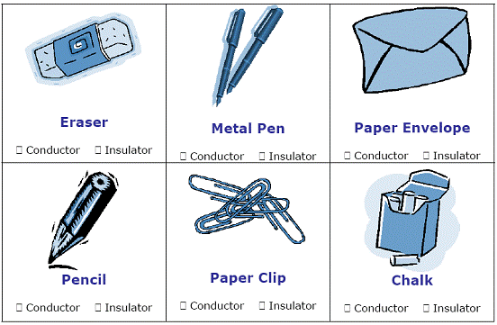
Different materials allow the flow of energy, in our case electrons, to varying degrees.

Slide 10
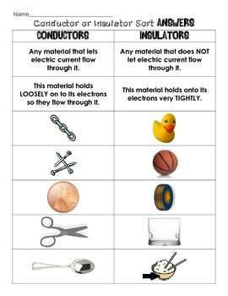
Materials that allow the easy flow of electrons are called conductors.
Materials that do not allow the easy flow of electrons are called insulators.

Slide 11
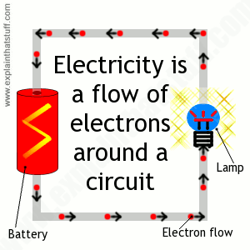
The rate of movement of electrons can be measured over a certain amount of time.
The current is defined as the rate of charge movement or the movement of electrons through an area over a given amount of time.

Slide 12
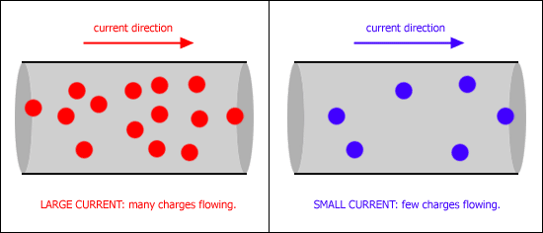
The faster the movement of electrons the higher the current.

Slide 13
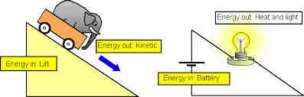
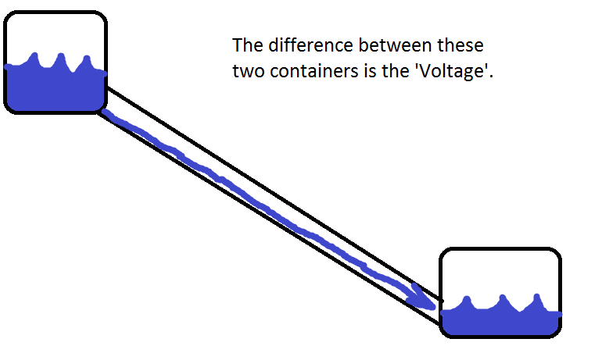
A major concept of electricity is potential difference, which is defined as the change in electrical potential energy between two points.

Slide 14
POTENTIAL DIFFERENCE
REMEMBER DIFFUSION?
HIGH TO LOW
Similarly, electric charges will flow from a point of higher potential(energy) to lower potential.
This difference in electric potential between 2 points in a circuit is known as the POTENTIAL DIFFERENCE. Its is the same as VOLTAGE also.

Slide 15
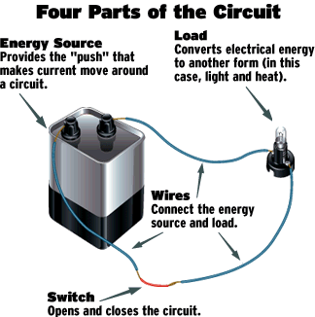
ELECTRIC CIRCUITS
Electric circuits are made up of electrical components.
These components must be joined together without any gap in between to form a Closed circuit.
Incomplete circuits are called Open circuits.

Slide 16
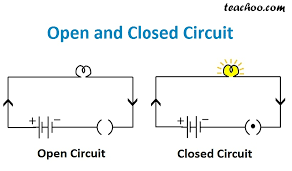

Slide 17
AN ELECTRIC CURRENT FLOWS ONLY WHEN THERE IS:
A source of electrical energy and
A closed circuit.

Slide 18
There is a standard set of scientific symbols used to represent different components in a circuit. The most commonly used symbols and what they represent are listed below, we will use these symbols in our drawings.
Component | Wire | Bulb / Lamp | Battery | Resistor | Open Switch | Closed Switch
Diagrams

Slide 19
Sometimes a circuit is complete but there is a problem of the current flowing too fast. This is called short circuit.
Short circuit – a circuit which contains little or no resistance
→ The components get too hot due to the excess current and not enough resistance to slow it down and can cause fires

Slide 20
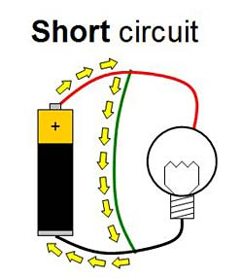
Examples:
- 2 terminals of a battery directly connected
- Uninsulated wires come into contact
→ These are very dangerous

Slide 21
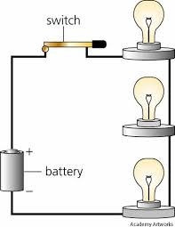
Series Circuits
1. Series Circuits - Circuit (or portion of) in which there is a single conducting path without junctions for electricity to follow

Slide 22
There are three different types of electrical circuits:
1. Series Circuits - Circuit (or portion of) in which there is a single conducting path without junctions for electricity to follow
2. Parallel Circuits - Circuit (or part of) where components are connected across common points and provides separate conducting paths for electricity to follow
3. Complex Circuits – Circuits with some segments being in series and other segment being in parallel to take advantage of the benefits of both

Slide 23
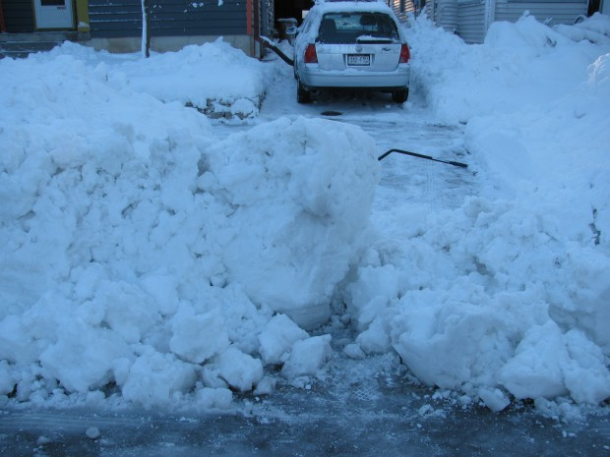
Some of the characteristics of series circuits are listed below and are important to remember when deciding which type of circuit to use.
Back to our road
to the store
example, in a
series circuit there
is one road and
one road only.
If part of the
road is out,
you cannot
get where you
want to go,
no exceptions.

Slide 24
All bulbs / resistors / components in series will have the same current. This is because the current can only flow as fast as the slowest (most resistant) component will allow.
The total current in a series circuit depends on the number of resistors present and resistance of each.

Slide 25

FACTS series circuits:
1. All parts have same current
2. If one part breaks, the whole circuits fails

Slide 26
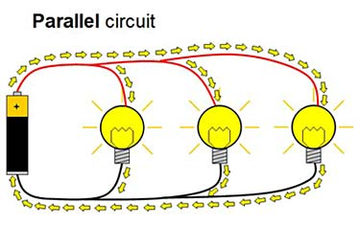
Parallel Circuits
2. Parallel Circuits - Circuit (or part of) where components are connected across common points and provides separate conducting paths for electricity to follow

Slide 27
Some of the characteristics of parallel circuits are listed below and are important to remember when deciding which type of circuit to use.
Back to our road to the store example, in a parallel circuit there is more than one road you can use as a possible route to the store. If one part of the road is out, you can choose a detour around it to still get where you want to go, or if the whole road is working, you can choose your path among several to get to the store.

Slide 28
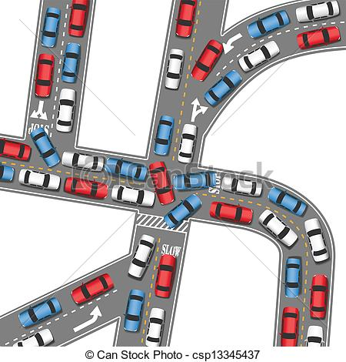

Slide 29
Below is a list of advantages and disadvantages of parallel circuits (notice some may be both)
Advantages of parallel:
1. Parallel circuits do not require all elements to conduct
2. One part can malfunction and the rest will continue to work
3. Potential difference does not change for all components when
one component fails
→ Home wired in parallel
Disadvantages of parallel:
1. Current will change if one component fails
2. Current different in all components

Slide 30
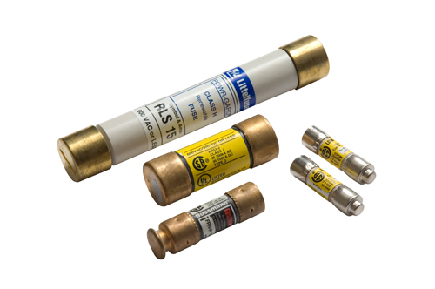
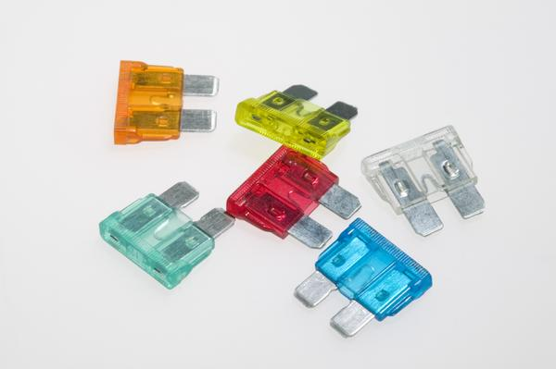
Fuse - small metallic strip that melts when current becomes too high.
→ Replacement necessary when melted

Slide 31
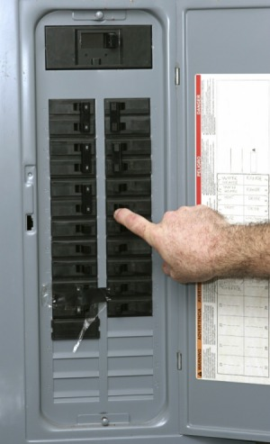
Circuit breaker - device that triggers a switch to open circuit when current is too high
→ reset switch when opened
Both are specially designed
for specific amounts of
current

Slide 32
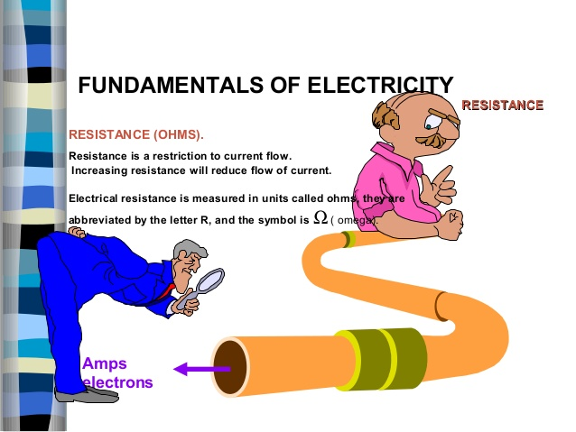
A second concept to deal with is resistance. Anything that slows down the flow of electrons is defined as resistance.

Slide 33
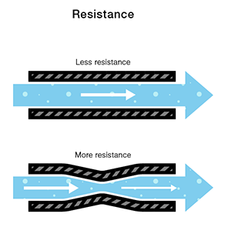
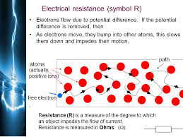
RESISTANCE
WHEN AN ELECTRIC CURRENT FLOWS THROUGH A CIRCUIT, THERE WILL BE SOME RESISTANCE THAT OPPOSES IT.

Slide 34
RESISTANCE
GOOD CONDUCTORS = LOW RESISTANCE
( electricity is able to flow through them easily)
POOR CONDUCTORS= HIGH RESISTANCE
(electricity is not able to flow through them easily)

Slide 35
Why should we use a Copper wire instead of a Nichrome wire?

Slide 36
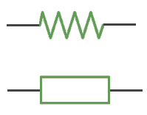
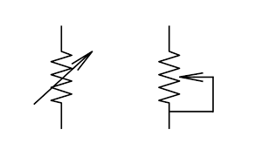
FIXED RESISTORS
VARIABLE RESISTORS

Slide 37
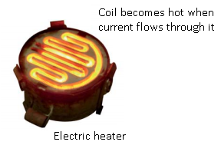
HEATING EFFECT OF ELECTRICITY
When an electric current flows through a wire, the wire heats up.. Electrical energy has been converted into Heat energy.
The greater the resistance of the wire, the greater the amount of heat produced.

Slide 38
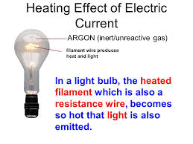
HEATING EFFECT IN A BULB

Slide 39
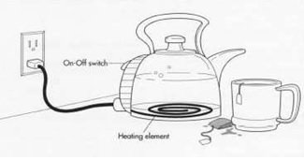
A kettle uses both copper and nichrome wires.
Cu has low resistance whereas Nichrome has high resistance.
Use of Cu wire for external wire as it has low resistance and produces less heat.
Use of Nichrome Wire for heating element as it has high resistance and produces a lot of heat.

Slide 40
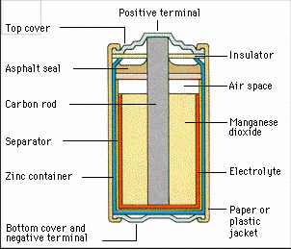
In our study of electricity, it is important to remember that energy is constantly converted in the following manner:
Chemical potential energy
is converted to electrical
potential energy in a battery.
2. Electrical potential energy is changed to thermal
energy, light, mechanical energy as the electricity
moves through the different materials.

Slide 41
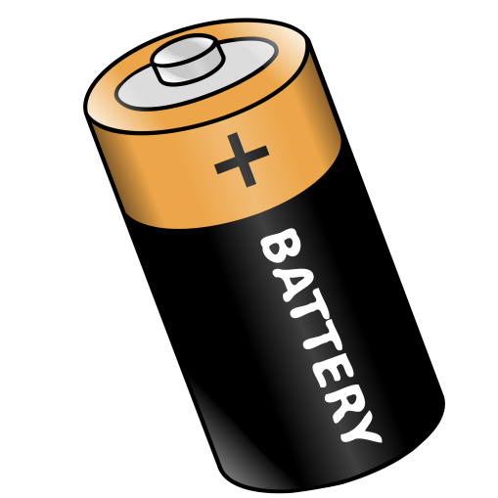
In every circuit there must be a source of the electric current.
This source is known as the EMF – Electromotive force → the energy per unit charge supplied by a source of electric current
→ A source of electrical energy
→ A “charge pump”
→ Examples are batteries and generators

Slide 42
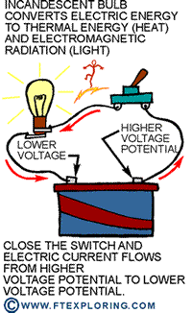
A battery changes chemical potential energy to electrical potential energy as it transfers the energy to the electrons in the battery. As they move along the circuit, the energy is then transferred to the different components, and dissipated (given off) usually as heat, light, or sound.

